Slide 1
Jasper soft
Sessions 71 & 72

Slide 2
DISCLAIMER
This presentation is only a summary of some of Adapt IT’s products, features and their latest developments. Adapt IT only intends for the information to give you an overview, and not a complete and comprehensive statement that necessarily suits your purposes.
Adapt IT reserves the right to change any information contained in this presentation and is not responsible for any loss that results from inaccuracies in the information. You may not distribute or reproduce the information without Adapt IT’s written permission.

Slide 3
Survey
Time spent on reporting
Jasper Usage 2021 - 2023
Embedded Jasper Reports
Jasper Features
Preferred mode of Training
Suggested Improvement
White Space Program
Stats
Questions?
Table of contents

Slide 4
Survey

Slide 5
March 2025 - Jasper Survey
Accountant
Acting Chief Financial Officer
Assistant Director Management Of Information Sytems (Mis)
Assistant Director Partnerships & Linkages
Assistant Registrar
Business Analyst
Business Process Manager/Architect
CFO
Data Analyst
DBA
Deputy Director Payroll
Deputy Director
Deputy Director Assets
Deputy Director General Ledger
Deputy Registrar
Director Human Capital
Director SCM And Expenditure
Hemis Officer
HOD - Sundry Payments
HR Business Analyst
IT Spercialist
Manager Reporting And Investments
Manager Analysis
Manager Payroll
Network Controller
Remunerations Officer
Senior Administrator Planning
Senior Assets Controller
Senior Business Development Manager
Senior Clerck
Senior Human Capital Practioner
Senior Officer HR Operations
Senior Registration Officer
Specialist Systems & Accounting
Statistician
Botswana Open University
Buffalo City TVET College
Cape Penninsula University of Technology
Central University of Technology
Durban University of Technology
Gert Sibande TVET College
Ingwe TVET College
King Hintsa TVET Collge
Nelson Mandela University
Orbit TVET College
Port Elizaberth TVET College
Sefako Mkgatho Heath Science University
Sol Plaatje University
Tshwane University of Technology
Univeristy Westren Cape
University of Fort Hare
University of Johannesburg
University of Kwa Zulu-Natal
University of Lesetho
University of Limpopo
University of Namibia
University of Rwanda
University of Venda
Vaal University of Technology
Vhembe TVET College
Walter Sisulu University
Surveyed 210
Respondents 51
Institutions 27
Universities 21
TVET 6
Max respondents per org
TUT 6
Venda 4
UNAM 4
VUT 4
Notes:
Response rate 24%
According to internet Email Surveys 20% – 30% good
Using a standard formula, for N = 210 and n = 51, the margin of error is approximately 12% at a 95% confidence level.
If 60% of respondents answered "Yes" to a question, the true percentage in the whole group could range between 48% and 72% (±12%).The survey results are informative but may not be fully representative due to the relatively small sample size.

Slide 6
Time spent on reporting

Slide 7
Time spent on reporting
Notes:
To understand reporting frequency
Reporting is Not a Major Time Burden
If most respondents spend minimal time on reporting, it suggests that the process is efficient, automated, or streamlined.
It may indicate that reporting tools (e.g., dashboards, templates, automation) are effective.
Potential Underreporting or Lack of Detailed Reports
If reporting is a critical task, but most people spend very little time on it, this might suggest:
Reports are too simplistic and lack depth.
Employees may not be reporting as frequently as expected
There could be inconsistencies in data collection or lack of standardized reporting procedures.
3. Opportunity for Process Improvement
If some respondents spend significantly more time than others, it may indicate uneven workload distribution or inefficient processes in certain teams.
If reporting is a key business function, but time spent is very low, consider evaluating report accuracy, completeness, and decision-making impact.

Slide 8
Jasper Usage 2021 - 2023

Slide 9
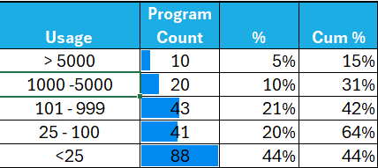
Jasper Usage 2021 - 2023
Option | Description | Usage
{SSTURA-3} | Credit Certificate | 40367
{FPRNR1-6} | Detail Per Earning/Deduction | 19256
{SRESIDE-51} | Residence Report | 16793
{SSTURA-12} | TVET Academic Transcript | 11149
{PLOPR1-1} | Print Detail Leave Records | 11045
{STIME1-1} | Lecturers Timetable for an Individual | 9825
{SREGR2-1} | Residence Report | 9599
{SSTUR1-1} | Exam Paper List | 8141
{SREGR5-1} | Print Full Biographical Detail for Admitted Applicants | 5676
{SREGR1-3} | List of Registered Students | 5255
{SSTURL-3} | Biographical Class Lists | 4784
{SREGR5-2} | Print Full Biographical Detail for Registered Students | 3644
{SNAPP-21} | Alpha/Numeric Report | 3079
{FPRNR2-5} | Variance Report | 2895
{SSTUR2-7} | Print Qualifications Awarded | 2799
{FPRNR1-1} | Pay Status Report | 2737
{PAOPR2-8} | Appointments / Resignations | 2580
{FPRNR1-2} | Net Salary Comparison | 1792
{FPRNR1-3} | Payslip Summary | 2177
{SNAPP2-2} | Print Admission Status | 2173

Slide 10
Embedded Jasper Reports

Slide 11
Embedded Jasper Reports
Notes:
To determine user engagement and whether user recognise and are aware that they are using Jasper.
21% frequently use the embedded reports
78% occasionally, rarely or never
Potential Issues:
Reports are not relevant to users' needs.
Users don’t know the reports exist or how to access them.
The interface is not user-friendly or reports are buried in the system.
Reports don’t provide actionable insights or the right level of detail.
Users prefer exporting data or using external tools (Excel, Power BI).

Slide 12
Jasper Features

Slide 13
Jasper Features
Drag-and-Drop Report Designer
Ad Hoc Reporting
Interactive Reports
Report Scheduling and Distribution
Data Visualization Tools
Template-Based Reporting
Parameterized Reports
Export Options
Collaborative Features
Notes:
Jasper Ad Hoc Reporting is a feature in TIBCO Jaspersoft that allows business users and non-technical staff to create, customize, and explore reports without needing advanced SQL or coding skills.
Self-Service Report Creation
Users can drag and drop fields to build reports.
No SQL or programming required—ideal for non-technical users.
Can generate tables, crosstabs, and charts on the fly.
2. Interactive Data Exploration
Filter, group, and summarize data in real time.
Drill down into data without modifying core reports.
Ad hoc views can be converted into full reports for scheduled delivery.
3. Data Source Flexibility
Works with relational databases (PostgreSQL, MySQL, Oracle, SQL Server).
Can pull data from Big Data, cloud, or web services (REST, XML, JSON).
Uses domains to simplify complex databases for end-users.
4. Report Export & Sharing
Users can export reports to PDF, Excel, CSV, and other formats.
Can schedule and distribute reports via email or dashboards.
Supports embedding within ERP, web applications, and portals.
Data visualization in Jaspersoft refers to the graphical representation of data using charts, graphs, dashboards, and interactive reports. It helps users easily interpret trends, patterns, and insights from their data.
Interactive Reports in Jaspersoft allow users to modify, filter, and analyze reports in real time without needing to redesign or regenerate them. These reports enable self-service data exploration, improving usability and decision-making.
In-Report Filtering & Sorting
Users can apply filters (date range, category, etc.) without re-running the report.
Allows sorting by different columns dynamically.
2. Drill-Down & Drill-Through
Users can click on data points to drill down into more detailed views.
Drill-through links allow navigation between reports (e.g., from a summary report to transaction-level details).
3. Column Show/Hide & Reordering
Users can toggle column visibility to focus only on relevant data.
Allows drag-and-drop column reordering without modifying the report structure.
4. Data Highlighting & Conditional Formatting
Apply color-coded highlights based on thresholds (e.g., revenue below $1M in red).
Helps users quickly identify trends, anomalies, or outliers.
5. Export & Sharing
Interactive reports can be exported to PDF, Excel, CSV, or Word while preserving formatting.
Users can save filtered views for later use.
6. Embeddable in Applications
Interactive reports can be embedded in web applications, ERP systems, and portals.
Enables role-based access control (different users see different levels of data).
Report Scheduling and Distribution in Jaspersoft allows users to automate report generation and delivery at specific times or intervals. This feature ensures that users receive timely, accurate, and relevant reports without manually running them.
Parameterized Reports in Jaspersoft allow users to input dynamic values (such as date ranges, customer IDs, regions, or product categories) to generate customized reports without modifying the report structure. This enhances flexibility and enables users to filter data on demand.
Template-Based Reporting in Jaspersoft allows users to create standardized report layouts that can be reused across multiple reports. These templates ensure consistency, branding, and efficiency by defining a pre-set design and structure while allowing dynamic content to be inserted.
. Role-Based Access & Permissions
Users can be assigned different roles (Admin, Viewer, Editor, etc.) to control access.
Ensures sensitive data is protected, while still allowing collaboration.
2. Shared Reports & Dashboards
Reports and dashboards can be shared across teams within JasperReports Server.
Users can collaborate on data insights by providing comments and annotations.
3. Version Control & Report History
Jaspersoft keeps version history of reports to track changes.
Users can revert to previous versions if needed.
4. Scheduled Report Delivery
Reports can be automatically generated and emailed to teams on a set schedule.
Ensures that all team members receive the latest data insights without manual intervention.
5. Ad Hoc Report Sharing
Users can create Ad Hoc Reports and share them without IT involvement.
Encourages self-service reporting within teams.
6. Embedding & Integration with Other Tools
Jaspersoft can be embedded into external applications, ERPs, and CRMs.
Reports and dashboards can be shared through web portals or custom applications.

Slide 14
Jasper Features Preference
Notes:
Jasper Ad Hoc Reporting is a feature in TIBCO Jaspersoft that allows business users and non-technical staff to create, customize, and explore reports without needing advanced SQL or coding skills.
Self-Service Report Creation
Users can drag and drop fields to build reports.
No SQL or programming required—ideal for non-technical users.
Can generate tables, crosstabs, and charts on the fly.
2. Interactive Data Exploration
Filter, group, and summarize data in real time.
Drill down into data without modifying core reports.
Ad hoc views can be converted into full reports for scheduled delivery.
3. Data Source Flexibility
Works with relational databases (PostgreSQL, MySQL, Oracle, SQL Server).
Can pull data from Big Data, cloud, or web services (REST, XML, JSON).
Uses domains to simplify complex databases for end-users.
4. Report Export & Sharing
Users can export reports to PDF, Excel, CSV, and other formats.
Can schedule and distribute reports via email or dashboards.
Supports embedding within ERP, web applications, and portals.
Data visualization in Jaspersoft refers to the graphical representation of data using charts, graphs, dashboards, and interactive reports. It helps users easily interpret trends, patterns, and insights from their data.
Interactive Reports in Jaspersoft allow users to modify, filter, and analyze reports in real time without needing to redesign or regenerate them. These reports enable self-service data exploration, improving usability and decision-making.
In-Report Filtering & Sorting
Users can apply filters (date range, category, etc.) without re-running the report.
Allows sorting by different columns dynamically.
2. Drill-Down & Drill-Through
Users can click on data points to drill down into more detailed views.
Drill-through links allow navigation between reports (e.g., from a summary report to transaction-level details).
3. Column Show/Hide & Reordering
Users can toggle column visibility to focus only on relevant data.
Allows drag-and-drop column reordering without modifying the report structure.
4. Data Highlighting & Conditional Formatting
Apply color-coded highlights based on thresholds (e.g., revenue below $1M in red).
Helps users quickly identify trends, anomalies, or outliers.
5. Export & Sharing
Interactive reports can be exported to PDF, Excel, CSV, or Word while preserving formatting.
Users can save filtered views for later use.
6. Embeddable in Applications
Interactive reports can be embedded in web applications, ERP systems, and portals.
Enables role-based access control (different users see different levels of data).
Report Scheduling and Distribution in Jaspersoft allows users to automate report generation and delivery at specific times or intervals. This feature ensures that users receive timely, accurate, and relevant reports without manually running them.
Parameterized Reports in Jaspersoft allow users to input dynamic values (such as date ranges, customer IDs, regions, or product categories) to generate customized reports without modifying the report structure. This enhances flexibility and enables users to filter data on demand.
Template-Based Reporting in Jaspersoft allows users to create standardized report layouts that can be reused across multiple reports. These templates ensure consistency, branding, and efficiency by defining a pre-set design and structure while allowing dynamic content to be inserted.
. Role-Based Access & Permissions
Users can be assigned different roles (Admin, Viewer, Editor, etc.) to control access.
Ensures sensitive data is protected, while still allowing collaboration.
2. Shared Reports & Dashboards
Reports and dashboards can be shared across teams within JasperReports Server.
Users can collaborate on data insights by providing comments and annotations.
3. Version Control & Report History
Jaspersoft keeps version history of reports to track changes.
Users can revert to previous versions if needed.
4. Scheduled Report Delivery
Reports can be automatically generated and emailed to teams on a set schedule.
Ensures that all team members receive the latest data insights without manual intervention.
5. Ad Hoc Report Sharing
Users can create Ad Hoc Reports and share them without IT involvement.
Encourages self-service reporting within teams.
6. Embedding & Integration with Other Tools
Jaspersoft can be embedded into external applications, ERPs, and CRMs.
Reports and dashboards can be shared through web portals or custom applications.

Slide 15
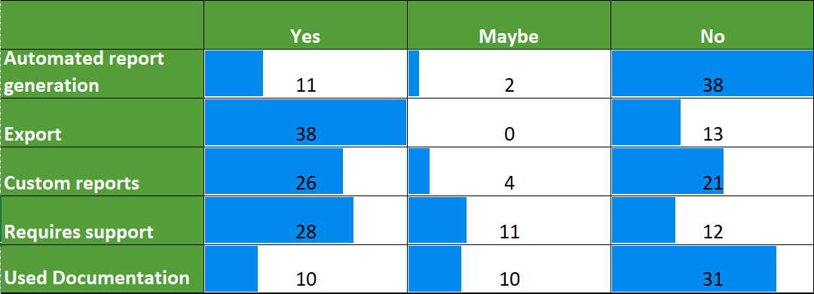
Feature Usage
Notes:
Have you used the scheduling feature for automated report generation ?
Are you familiar with the different export formats available in Jasper Reports (e.g., PDF, Excel, CSV)?
How easy is it to filter, sort, or drill down into data within Jasper Soft reports ?
Are you aware of the ability to create custom reports within Jasper Reports ?
Do you need technical assistance to create reports, or do you manage on your own?
Have you used the documentation or help resources provided by Adapt IT relating to Jasper Soft? Was it useful?

Slide 16
Preferred mode of Training

Slide 17
Preferred mode of Training
Notes:
75 % respondent indicate that if we provided them with training document & tutorial it would help to use Jasper better
60% of respondent have indicated that they have not looked at the Jasper documentation currently

Slide 18
Suggested Improvement

Slide 19
Suggested Improvement
Suggestions | Count
No Suggestion | 22
Training | 12
Insights | 4
Awareness | 2
Training / Consultation | 2
Alternate Reporting Solution | 1
Consultation Count | 1
Licencing | 1
Managing Jaspersoft | 1
ODBC | 1
Performance | 1
Real Time Dashboards | 1
Support | 1
Training / Support | 1
Total | 51
Notes:
22 – no suggestion – don’t work with, don’t know 43 %
16 – training / consultation
4 – insights – better reports , dashboards
2 – awareness marketing Jasper and its capabilities to user
Other
To be invited back for testing / DTS

Slide 20
White Space Progam

Slide 21
White Space Program
White Space | Recurrence
Cohort analysis | 1
Customized Jasper reports and training | 11
Jasper Soft - Studio | 1
Jaspersoft Administrator and Server Training | 2
JasperSoft Scheduling of Reporting | 1
Residence - scheduled reports and training | 1
Notes:
Out of 27 clients visited

Slide 22
Stats

Slide 23
Notes:
Only 13 respondents
5 from the same university
8 Institutions
Siyabulela Gegana, WSU,Eugene Adams WCCHeinrich Meyer, Port Elizabeth TVET College, TVETMIS, Barbara Barfoot, Orbit TVETC, System Administrator

Slide 24
Questions
Questions ?

Slide 25
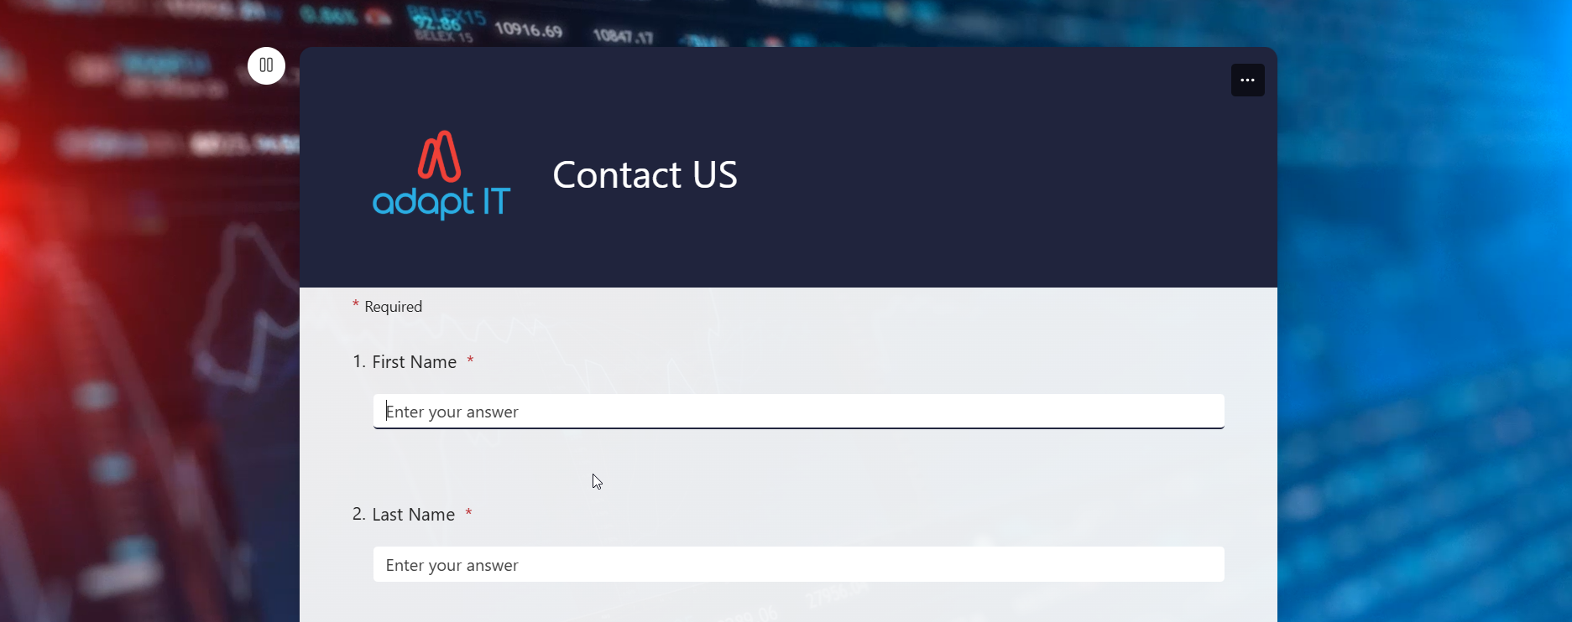
https://forms.office.com/r/L2HZWtTz3n

